Slide 1
Managed camps Update

Slide 2
Overall approach
Today
September
October
November
December
Finalize camp Locations
RFP for Manager
Open first camp
Open second camp
Expedite
RFP for Navigation Center
Open the Navigation Center
Development Code Changes & Identify Land for Safe Parking
County identified land for affordable housing
RFP selection
Fast Track
Renovations at Division St Shelter
Close on 2nd St
Renovations at 2nd St Shelter
Medium Term
Identify Land RV Parks
RFP for RV park
Begin entitlement on Camp Sites

Slide 3
Sanctioned encampment Site Characteristics
Site Priorities for Operators
15-25 sites/campers
Perimeter markings
Access to water
Circulation, space for Medical van
Estimated $300K-$400K annually
Proximity to social services, transit, employment etc
Essential Site Characteristics
Undeveloped
Publically owned
Existing street access
Existing water service
Street Address (or ability to get one)
Ability (with entitlement work) to approve permanent transitional housing/shelter

Slide 4
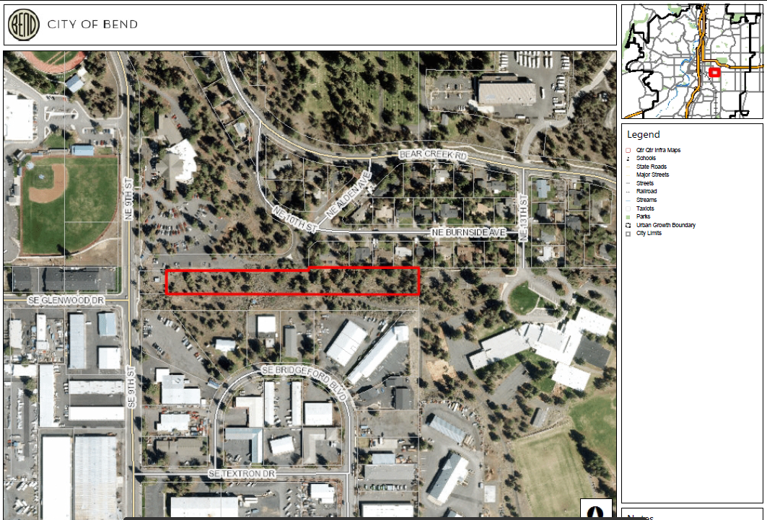
Site #1 | 9th Street

Slide 5
Site #1 | 9th Street
Agreement from Council to proceed
Begin conversations with adjacent neighbors
  Followed by open public meetings
Site visit with Parks
Overall site plan and approval under HB 2006
Open RFP for service provider to manage camp
Overall agreement on site plan for future permanent structures

Slide 6
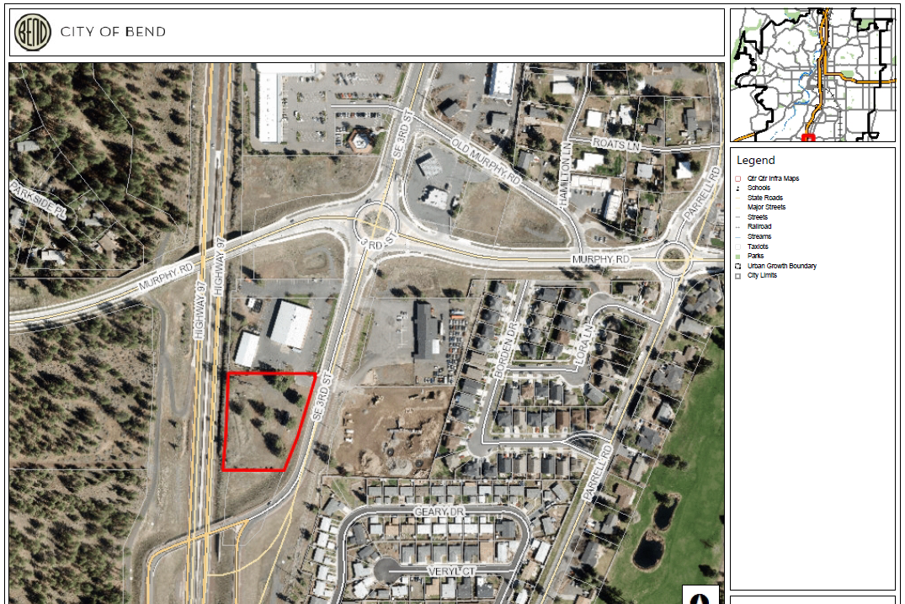
Site #2 | SE 3rd Street

Slide 7
Site #2 | SE 3rd Street
Agreement from Council to proceed
Begin conversations with adjacent neighbors
  Followed by open public meetings
Contingent on successful negotiation of agreement with ODOT
Overall site plan and approval under HB 2006
Open RFP for service provider to manage camp
Overall agreement on site plan for future permanent structures

Slide 8
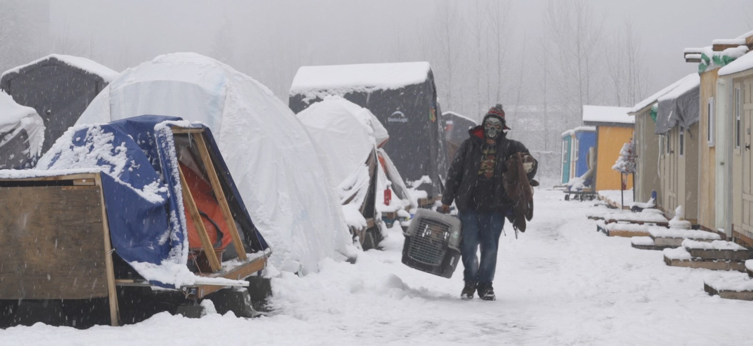
Photo credit: Stories of Us: Camp Second Chance, Melinda Raebyne

